Slide 1

By Ritesh Sanjeevan Nikam
Data Science with Python Career Program - Capstone Project

Slide 2

Agenda
Data Exploration
Data insights
EDA Graphs.
Graphical Analysis and conclusion on Data
Data Cleaning & Pre-Processing Steps.
ML Modeling
Deployment of ML Models using Streamlit.

Slide 3
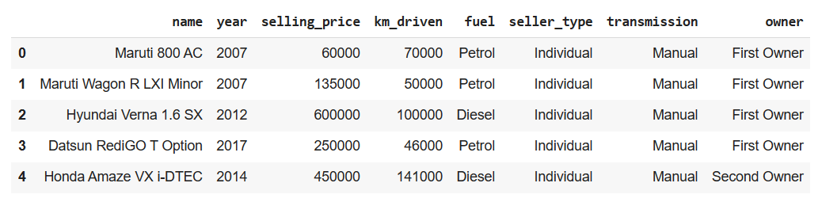
Data Exploration
Above screenshot is of the pandas data-frame created using the CAR DETAILS.csv file

Slide 4
Data Exploration
Summary of the dataset :
name [Categorical] : name is combination of two data points brand + model.
year [Numerical] : year columns represents the year in which the car is sold.
selling price [Numerical] : this is our target variable. This feature is selling price of the car.
km_driven [Numerical] : this total number of distance travelled by cars.
fuel [Categorical] : this feature can have following values – Diesel, Petrol, CNG, PNG, Electric.
seller_type [Categorical] : this feature can have following values – Individual, Dealer, Trustmark Dealer.
transmission [Categorical] : can be either manual or automatic.
Owner [Categorical] : owner feature can take five values – First Owner, Second Owner, Third Owner, Fourth & Above Owner, Test Drive Car.

Slide 5
Data insights
Most cars in dataset are from petrol or diesel powered.
Most of the time cars are sold individually without a dealership or trustmark dealer.
Majority cars being sold have manual transmission.
Observing dataset we can conclude that most cars being sold had either first or second ownership.

Slide 6
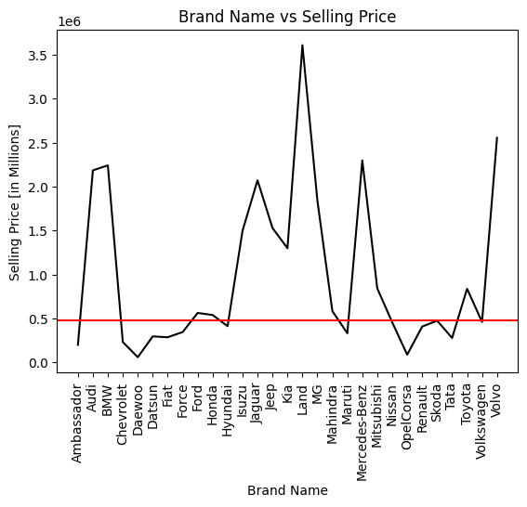
Data insights
There are some car brands that have very high selling price, three times the mean selling price.
These are as follows.
Toyota
Audi
BMW
Mercedes-Benz
Ford
Mahindra
Jaguar
Hyundai

Slide 7
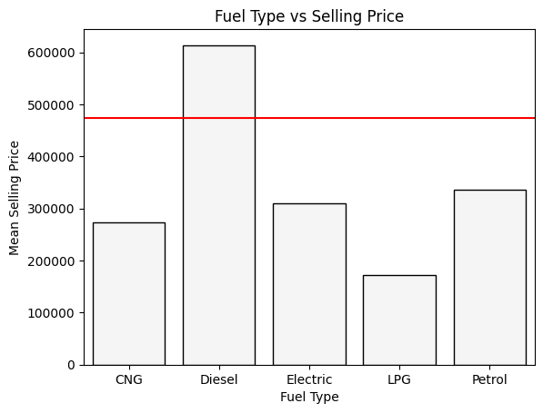
EDA Graphs.
Cars powered by Diesel have higher selling price that average selling price.

Slide 8
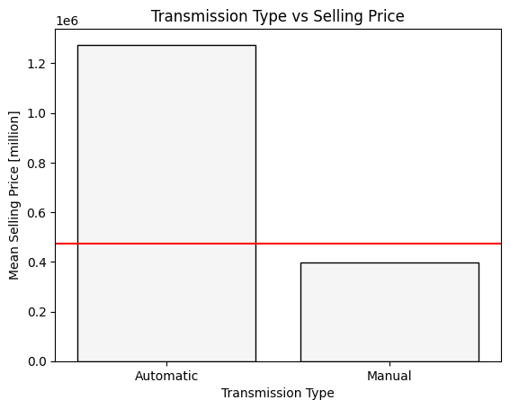
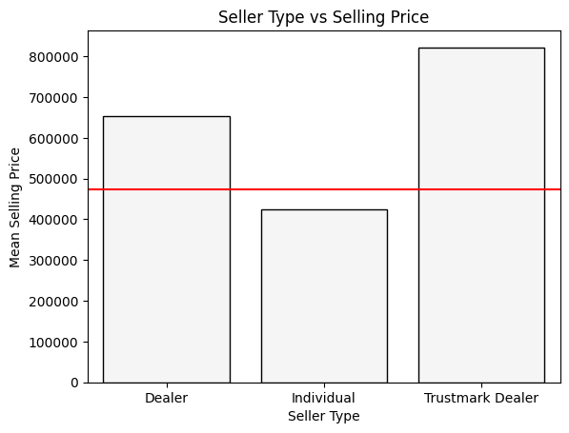
Graphical Analysis and conclusion on Data

Slide 9
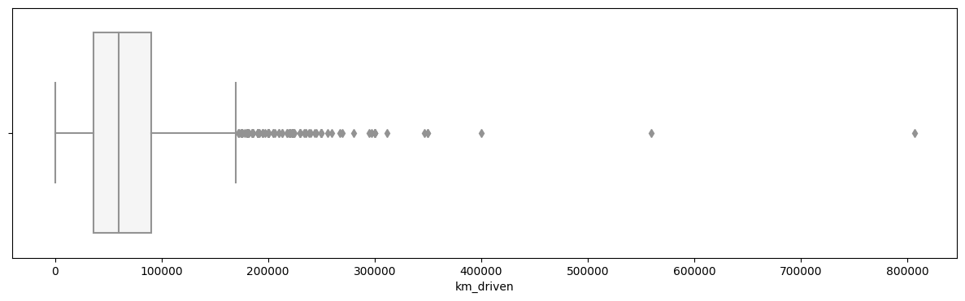
Graphical Analysis and conclusion on Data
Observing data we can conclude that, problem is a regression problem (Since, the target variable – selling_price – is continuous.
Analysing the km_driven column, we can observe that there are many outliers in the column.

Slide 10
Data Cleaning & Pre-Processing Steps.
There are no null values in the dataframe.
But there
are duplicate values in the dataframe we will drop this rows.
First feature name is combination of two information (brand + model), We can safely ignore model and only use brand for our analysis.
We will drop name column.
We have to use OneHotEncoding on brand name.
And we will use LabelEncoding on other categorical columns – fuel, seller_type, transmission, and owner.
As we have observed that there are many outliers in the km_driven column, we will perform outlier handling on this feature.

Slide 11
ML Modeling
As discussed earlier, this is a regression problem. We will apply following regression models one by one.
Linear Regression
Ridge Regression
Lasso Regression
Tree Regressor
Bagging
Gradient Boosting

Slide 12
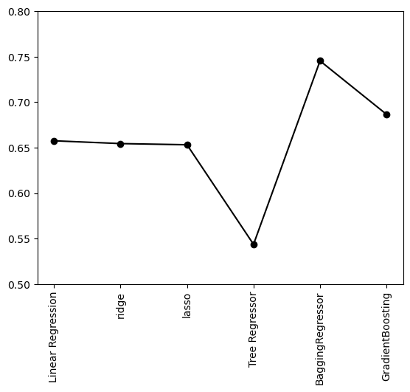
ML Modelling
Adjacent plot is depicting r2_score for all the regression models.
Here we can clearly see that Bagging Regressor have best score.
Linear Regression | 0.66
Ridge Regression | 0.65
Lasso Regression | 0.65
Tree Regression | 0.54
Bagging | 0.74
Gradient Boosting Regressor | 0.64

Slide 13
ML Modelling
Best model that is Gradient Boosting Regressor model has r2_score of 0.72.
We will store this model using pickle library.
with open(path + "best_model.pkl", "wb") as model_file: pickle.dump(gradient_boosting_reg, model_file)
with open(path + "best_model.pkl", "wb") as pickle_in: model = pickle.load(pickle_in)

Slide 14
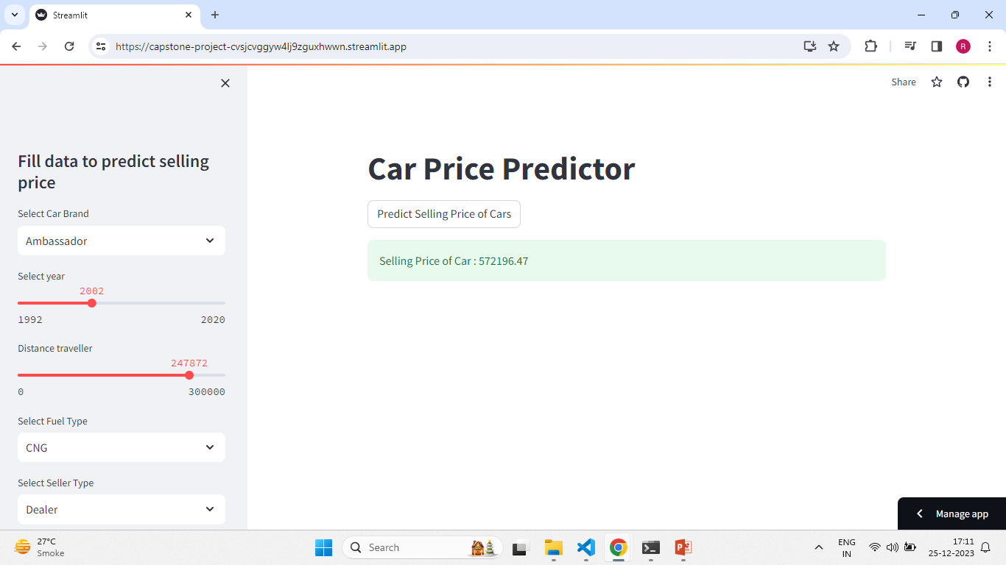
Deployment of ML Models using Streamlit.
Streamlit App

Slide 15
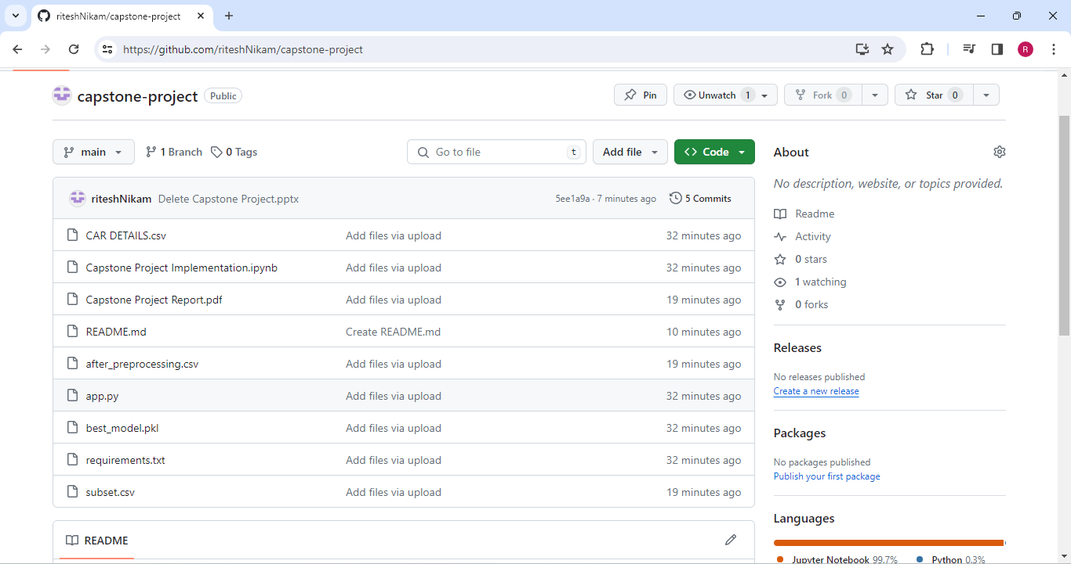
Deployment of ML Models using Streamlit.
GitHub Repo

Slide 16
Endnotes
Reference Links:-
Streamlit App : https://capstone-project-cvsjcvggyw4lj9zguxhwwn.streamlit.app/
GitHub Repository : https://github.com/riteshNikam/capstone-project.git

